Slide 1
WAN Protocol

Slide 2
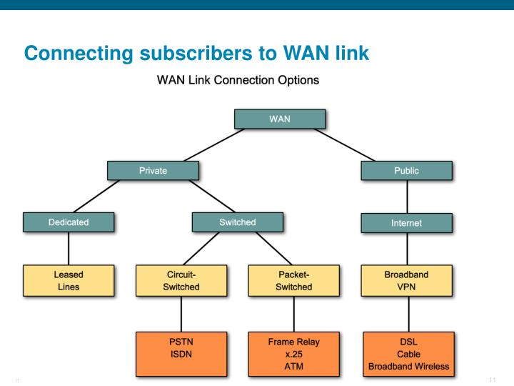
WAN Link Options

Slide 3
WAN Protocol’s
Leassed Lines uses two types of WAN encapsulation protocols ;
1) High Data Link Protocol (HDLC)
2) Point-to-Point Protocol (PPP)
High Data Link Protocol (HDLC) :-
Higher level data link Control protocol
Cisco Proprietary Layer 2 WAN Protocol
Doesn’t support Authentication
Doesn’t support Compression and error correction
2) Point-to-Point Protocol (PPP) :-
Point-to-Point Protocol
Standard Layer 2 WAN Protocol
Supports Authentication
Support error correction

Slide 4
PPP uses two Protocol’s
NCP: Network Control Protocol
LCP: Link Control Protocol
NCP: Network Control Protocol
NCP will make sure you can run different protocols over our PPP link line IP, IPv6 but also CDP(Cisco Discovery Protocol) and older protocols like IPX or AppleTalk.
So in short if you enable PPP on both routers this is what happens :
1. LCP : Takes care of setting up the link
2. NCP : Makes sure we can send IP and other protocols across our PPP Link.
PPP supports two Authentication protocols ;
1) PAP (Password Authentication Protocol)
2) CHAP (Challenge Handshake Authentication Protocol)

Slide 5
PAP (Password Authentication Protocol)
PAP provides a simple method for a remote node to establish its identity using a two-way handshake.
PAP is Done Only upon initial link establishment.
PAP is not strong authentication Protocol.
Password are sent across the link in clear text.

